Slide 1

ILM Best Practice for EPA Portfolio focusing on
Level 3 Team Leader/Supervisor &
Level 5 Operations/Departmental Manager
Karen Egan
Technical Advisor ILM
Karen.Egan@i-l-m.com

Slide 2
Aims and content of today’s Session
Update on our response and support regarding Covid-19
Overview of the EPA Journey
The assessment components and how they’re delivered at each level
Good practice for the Portfolio of evidence
Feedback from Lead Independent End Point Assessors
Support for Centres and Learners
EPA Guidance documentation
Open Q&A and discussion

Slide 3
Our response to the Covid-19 Pandemic
Please go to our dedicated web page
https://www.i-l-m.com/covid-19
for all other aspects of our support during this time including:
On-line events
E-workbooks
EPA Guidance
Oher useful information and links

Slide 4
Our response to the Covid-19 Pandemic
We are running a webinar
EPA Remote Invigilation - Covid-19 Period.
Thursday 7 May at 11 am – midday
The session will cover a full overview of the requirements to conduct the Home EPA testing solution for EPA evolve exams. Which standards we have EQA approval for, what the requirements are for set up and how you will run and conduct the remote invigilation.
You will also have time to ask any question at the end of the session.
Click here to book your place

Slide 5
What is EPA?
Assessment(s) undertaken at the end of an apprenticeship by an independent End Point Assessment Organisation (EPAO).
Carried out in line with the Assessment Plan to measure a candidates performance against the knowledge, skills and behaviours set out in the apprenticeship standard set by the Trailblazer Group.
Knowledge
Skills
Behaviours
Notes:
End Point Assessment (EPA) is the very last stage of the apprenticeship. It’s a separate and independent stage at the end of the apprenticeship undertaken by a third party organization not involved in the delivery of the apprenticeship training.
It measures the knowledge, skills and behaviours that an apprentice has gained during the apprenticeship and grades their performance against the apprenticeship standard.
ILM – part of the City and Guilds Group), as an independent End Point Assessment Organisation (EPAO), will carry out the EPA against the assessment plans put together by the Trailblazer group.
ILM also offers End-point Assessment through the City & Guilds EPA team for the level 5 operations/Departmental Manager, the Chartered Manager Degree Apprenticeship standard and the Senior Leader Master’s Degree Apprenticeship standard.

Slide 6
The EPA Journey

Slide 7
EPA Journey
Assessment starts
Assessment
ends
Gateway
Assessment
Certificate
Register
Reserve
Book
the employer and provider must confirm that the apprentice is ready for EPA and all gateway requirements have been met
Independent End Point Assessor (IEPA) will carry out assessments as set by the EPAO in line with the Assessment Plan.
Link: City & Guilds 8 Step Guide to your EPA journey
Notes:
There are 3 main stages in the EPA process - these are the Gateway, the actual assessment and the certification.
At the Gateway the employer and the provider need to confirm that the apprentice is ready for EPA and that all gateway requirements have been met (including achievement of any mandatory qualifications listed in the standard).
There are a number of steps to undertake as part of each stage.
For a full and detailed description of the process and the City & Guilds / ILM EPA Terms and Conditions refer to the City & Guilds Manual for the End-Point Assessment Service. Available for download from the ILM and City & Guilds website. The EPA Manual can be accessed using the following link:
Opens manual directly - https://www.i-l-m.com/~/media/ilm%20website/documents/learning-development/epa/manual%20for%20the%20end%20point%20assessment%20service%20-%2029%20jan%2018%20final%20pdf.ashx
- Links to EPA page – Manual and other useful links at bottom of the page - https://www.i-l-m.com/learning-and-development/management-apprenticeships/apprenticeships-for-training-providers/why-ilm-management-apprenticeships/end-point-assessment-explained#Getting-Started

Slide 8
The timeline of assessment
At least 2 weeks in advance
At least 1 week in advance
Booking
Evidence submission
Knowledge test
Interview,
Professional Discussion, Presentation & Q&A
End of
Apprenticeship
Notes:
Following the Gateway the provider/employer can make a Reservation for the EPA. This should take place approximately 90 days prior to EPA. The EPA Team will then contact you to discuss the range of potential EPA dates, relevant deadlines for Assessment Evidence and to confirm resourcing requirements. The EPA Team will aim to match an IEPA to this availability.
After the reservation and at least 2 weeks before EPA you need to upload the portfolio evidence. You must also book the knowledge test separately via Walled Garden. This must be taken at least 1 week before the competency-based interview and professional discussion. The competency-based interview and professional discussion will take place on the date and time pre-arranged by the EPA Team. they can take place on the same day or separate dates depending on availability and your preference.
Please note – the apprentice should NOT take the evolve knowledge test before clearing gateway – if this happened the test will be void and will have to be taken again.

Slide 9

Level 3 Assessment components & delivery methods
Assessment Method
Delivery Method
Knowledge test using scenarios and questions
Onscreen test
e-volve platform
Assessment of portfolio of evidence
Online
EPA Portal
Structured competency-based interview
Live online interaction
assessor, apprentice
GoToMeeting
Professional discussion relating to CPD activity

Slide 10
Level 5 Assessment components & delivery methods
Assessment Method
Delivery Method
Knowledge test using scenarios and questions
Onscreen test
e-volve platform
Assessment of portfolio of evidence
Structured competency-based interview
Online
EPA Portal
Presentation on work based project with Question and Answer session
Live online interaction
assessor, apprentice
GoToMeeting
Professional discussion relating to CPD activity

Slide 11
Assessment Components - Weighting
Level 3 Team Leader/Supervisor
50%
Minimum to pass
30%
20%
30%
20%
Option to resit assessment component failed
Knowledge Test
Portfolio of evidence
Structured
competency
based interview
Professional
discussion relating to
CPD activity
Notes:
For this standard the apprentice will be assessed in four ways to provide a clear indication of their knowledge, skills and behaviours. These methods are: Knowledge Test using scenarios and questions, structured competency based interview, portfolio of evidence and a professional discussion relating to CPD.
All candidates must participate in all four elements of the End Point Assessment and achieve a minimum of 50% for each component. The components do not have equal weighting. The first two have higher weighting at 30% from the overall mark each; whereas the latter two carry 20% weighting. This means that a total of 30 marks are available for the knowledge test and the structured interview and a total of 20 marks are available for each of the other methods. The apprentice will need to achieve at least 15 marks to pass the KT and structured interview and at least 10 marks to pass the other two components.
Apprentices who fail the End Point Assessment will only have to repeat the assessment that was failed. An apprentice should not be allowed to re-sit until it is evident that further study has been undertaken and they are ready to resit the assessment. Apprentices will not be allowed to repeat assessments that have been passed in order to gain a higher mark.
Although there are no restrictions in terms of re-sitting for this occupation, multiple assessment opportunities are not expected. You should be confident that the apprentice is ready to start the End Point Assessment with practice runs taking place before formal assessment.
The assessment will be undertaken by the same IEPA which we appoint.

Slide 12
Assessment Components - Weighting
Level 5 Operations/Departmental Manager
50%
Minimum to pass
30%
20%
20%
20%
10%
Option to resit assessment component failed
Knowledge Test
Portfolio of Evidence
Competency
based interview
Presentation on work-based project and Q&A
Professional
discussion relating to
CPD activity
Notes:
For this standard the apprentice will be assessed in five ways to provide a clear indication of their knowledge, skills and behaviours. These methods are: Knowledge Test using scenarios and questions, structured competency based interview, portfolio of evidence, presentation based on a work-based project followed by a Q&A and a professional discussion relating to CPD.
All candidates must participate in all five elements of the End Point Assessment and achieve a minimum of 50% for each component. The components do not have equal weighting.
Apprentices who fail the End Point Assessment will only have to repeat the assessment that was failed. An apprentice should not be allowed to re-sit until it is evident that further study has been undertaken and they are ready to resit the assessment. Apprentices will not be allowed to repeat assessments that have been passed in order to gain a higher mark.
Although there are no restrictions in terms of re-sitting for this occupation, multiple assessment opportunities are not expected. You should be confident that the apprentice is ready to start the End Point Assessment with practice runs taking place before formal assessment.
The assessment will be undertaken by the same IEPA which we appoint.

Slide 13
Grading
Fail
Pass
Merit
Distinction
Less than 50 marks
50 marks
& above
60 marks
& above
70 marks
& above
Notes:
The grading will be undertaken by the IEPA and it is applied at the very end of the EPA after all components have been successfully passed. Marks will be allocated across all areas being assessed, with a maximum possible mark of 100.
The IEPA will award marks based on each assessment component within the EPA and these will be added together. The final grade awarded will depend on the final mark achieved. As a result consistency of performance is key at EPA – scoring well across all components will provide the apprentice with the best opportunity of achieving a Distinction grade.

Slide 14
Focus on…
Portfolio of evidence
Testing Application of knowledge and demonstration of skills and behaviours relating to:
Leading people (Skills)
Managing people(Skills)
Building relationships (Skills)
Communication (Skills)
Operational management (Skills)
Project management (Skills)
Finance (Skills)
Self-awareness (Knowledge and skills)
Management of self (Knowledge and skills)
Decision making (Knowledge and skills)
Behaviours - taking responsibility,
inclusivity, agile, professionalism – behaviours won’t be marked but will expect to see them
All skills
assessment criteria
Knowledge criteria from 3 Personal Effectiveness units
Behaviours
and CPD
Notes:
This assessment methods causes the most challenges for both level 3 and 5 so we’ll spend a bit of time here

Slide 15
Portfolio timeline
(1)
From Start of programme
Get into the habit of gathering evidence
(2)
Last 6-3 months
Begin process of selecting which are the best pieces of evidence for the EPA Portfolio
(3)
At least 14 days before live on-line assessment activity
Naturally occurring evidence such as work plans, emails, meeting notes, supervisor/manager meeting notes, discussions but NOT guided!
Check for gaps – is there sufficient for each Assessment Criteria?
Submit work for End-point assessment

Slide 16
Activity & Discussion – Portfolio of Evidence
Spend a couple of minutes considering the following questions:
What assessment approach is the most appropriate when producing a portfolio of evidence – gathering discrete pieces of evidence for each criteria or planning larger activities to meet multiple criteria?
What kind of activities will provide the best evidence for skills related criteria?
What evidence types will best demonstrate a candidates’ knowledge, skills and behaviours in the workplace?
What would be the key characteristics of a good sample evidence matrix? – think about the mix of evidence types and how they map to a range of criteria, consider the clarity of referencing, consider the quantity of evidence gathered.

Slide 17




Portfolio of evidence – Evidence types
Work products
Reports
Presentations
Performance reviews between employer and apprentice
Observations (recorded by the training provider)
Ongoing professional discussions between apprentice and training provider relating to projects and assignments (recorded by the training provider)
Reflective statements
Feedback from line manager, direct reports and peers including 180/360 degree feedback approaches
Reports
Presentations
Work products
Notes:
The portfolio of evidence will be reviewed and assessed by the IEPA, who makes a
judgement on the quality of the work. It will comprise a collection of evidence (in an online
portfolio with written, audio and video evidence) which might include:
• Work products
• Reports
• Presentations
• Performance reviews between employer and apprentice
• Written statements
• Observations (recorded by the training provider)
• Ongoing professional discussions between apprentice and training provider relating
to projects and assignments (recorded by the training provider)
• Feedback from line manager, direct reports and peers including 180/360 degree
feedback approaches
Can’t stress enough all criteria must be met will not be compensated in the competency based interview.

Slide 18
General guidance for the portfolio
  The Portfolio needs to holistically show:
  Application of knowledge learnt
  Acquisition and demonstration of skills
  Demonstration of behaviours
Holistic approach
  As candidates become independent in their work and complete larger activities
  likely to provide the most holistic evidence - i.e. covering a number of criteria at once.
  Select evidence that most efficiently meets all the relevant criteria and which demonstrates their best performance.
Contextualised
  Contextualisation by learners is key, it allows them to demonstrate
  the role they played in creating the evidence presented, and
  provides a platform for the learner to demonstrate why they made decisions, why they chose to implement a certain model, etc.
Authenticated
  (signed off that it is that of the apprentice)
  e-signature matching authentication form on each piece of evidence.
Notes:
Evidence collected towards the end of their apprenticeship program, as candidates become independent in their work and complete larger activities, is likely to provide the most holistic evidence - i.e. covering a number of criteria at once. From this, they should select evidence that most efficiently meets all the relevant criteria and which demonstrates their best performance.
Contextualised – Contextualisation by learners is key, it allows them to demonstrate the role they played in creating the evidence presented, and provides a platform for the learner to demonstrate why they made decisions, why they chose to implement a certain model, etc.
Evidence must be authenticated (signed off that it is that of the apprentice) – e-signature matching authentication form on each piece of evidence.
Holistically – one piece of evidence can meet a variety of criteria
Evidence of authenticity – all need to sign once as their work

Slide 19
Tips for compiling a portfolio:
There are large number of criteria to assess so only include evidence that is relevant
Plan/map work activities to assessment criteria to identify how a holistic approach can be adopted – proper planning can significantly reduce the assessment burden for all involved
Use the sample evidence matrix (or similar) so that the evidence is easy to find for the IEPA – clear, accurate referencing will make it easier for all to see how the candidate has met the criteria and how evidence is being used.
Quality of evidence – e.g. ensure observations/ recordings are clear, with audio or visual aspects of a high enough quality to be able to make an assessment decision.
We want to see apprentices best work – so if you have evidence of chairing 6 team meetings – pick the best one!

Slide 20
End-point Assessment Team
General guidance for the portfolio
Evidence must meet the requirements of VACS:
  Valid/Relevant – it must be obtained in a real working environment that accurately reflects the candidates day-to-day work. It must relate to the criteria being evidenced.
  Authentic – it must be the candidate’s own work, unguided and in a real working environment (where possible). It must be clear what role the candidate has played in producing the evidence presented
  Current – the evidence must have been produced while the learner was on-programme/doing their apprenticeship.
  Sufficient – the evidence must fully cover the criteria it’s intended to, partial coverage of an assessment criteria does not demonstrate full knowledge or competence.

Slide 21
Preparing for submission
Evidence being uploaded for end‐point assessment must be presented as follows:
Evidence must have a header on each page containing the name of the
apprentice together with the date the evidence was produced;
Along with an evidence reference form (sample found in the end‐point assessment recording forms for centre /end‐point assessment customers document) completed to
    Cross‐reference each criterion to the relevant piece of evidence
    Formally declare the authenticity of all evidence.
Each piece of evidence must be referenced to the criteria it is being submitted against.
for example using a evidence reference matrix/form and clear evidence the headers/titling.
Functional skills/GCSE equivalent certificates uploaded.
Photographic ID must be presented on the day by the apprentice

Slide 22
Feedback from LIEPAs
Portfolio
Be aware of the verb in the assessment criteria
Product evidence, Product evidence, Product Evidence!!
Over reliance on Professional Discussions
Weak witness statements
    E.g. “the apprentice managed the meeting well” does not demonstrate that the apprentice met the criteria.
    Statements should
      What was the meeting about
      What did the apprentice do
      How did they do it

Slide 23
S.T.A.R.R: A way to think about portfolio evidence
The key thing we want to see in a Summative Portfolio: show us what you do. This method could also be used when writing up “projects” that are required at level 5 as evidence using S.T.A.R.R as a useful approach.
Situation: What were you asked to do, why and by whom? This can include regular routine activities, a collection of smaller activities on a single theme or a distinct task/project that has been set.
Task: The detail of what you propose to do and the plan of actions to be undertaken, with explanation as to why you have decided to do things in a certain way and why elements of the plan have be done in a certain order.
Action: Walk through what you are doing/did with screenshots, photos, etc. and appropriate annotation.
Result: What was the outcome of the work you carried out? Success/failure? Who provided feedback? Did you hand the work over to someone who signed off the completion?
Reflection: Did it go to plan? Did the outcome and activity run as you expected? What would you do faced with a similar task in the future – do the same things or different? What else might have helped you carry out the task?

Slide 24





S.T.A.R.R: Example
I manage a small budget within my area of work which has different elements of income and expenditure. It is my responsibility to monitor the spend and income and report back to my manager on a monthly basis.
Here is the overview of the budget and each of the income /expenditure elements that need to be reviewed and checked. I have shown what time it should take for me to gather this information and the deadlines I need to meet. As part of my plan, I will check records of expected activity and liaise with various departments to check all costs and invoices have been processed.
These are the checks I perform (screenshots with annotation). This is how I ensure all activity has been recorded (screenshots with annotation). Here are examples of the budget analysis I carried out comparing expected activity against actual (screenshots with annotation).
All the is recoded and here is the report to my manager OR not all of the activity was not processed and here is my report to my manager with an action plan to remedy this.
This is the feedback I received about the work I had done. While it was successful/not successful this is what I think went well/bad and I would recommend a change/no change to this process in the future. Changes to be outlined if appropriate.

Slide 25
Frequently Asked Questions (1)
Question | Answer
Are the on-programme qualification certificates enough for the Outcomes in the Summative Portfolio? | No. We need to see how the apprentice links what they have learned to what they do.
Can apprentices use a report format they are familiar with? | Yes there is no template for this
Should I include everything the apprentice has done in the portfolio submitted for EPA? | No. It is meant to be Summative, so the best they have per Outcome.
Should I include some early work and then their improved work for the portfolio? | No. We want to see what they have become and not the journey, unless it is to show why they make a specific decision, carry out a task or act in a particular way.
Does the portfolio have to be submitted in a word processed document? | No. Many Standards will allow alternatives, especially if you have apprentices that are uncomfortable with long written documents.

Slide 26
Frequently Asked Questions (2)
Question | Answer
What sort of things can lead to an apprentice failing? | Not meeting all the Outcomes in the Summative Portfolio
 | Providing an Employer Reference that talks about what the company does or what the team does rather than specifically what the apprentice has contributed.
 | Providing evidence – including witness testimonies – that have had a grading decision made by the tutor assessor as part of the submission.
Should we still review and IQA work? | Yes. While you are not making judgements, you still need to ensure your apprentices have covered all Outcomes of the Standard required. Allows for gap analysis before submission of evidence. Check work has been signed to state it is their own work. No unnecessary duplication is being submitted or work that has no relevance to any Outcome. It is “I” and not “we”.

Slide 27
Delivery model - Recap
Tests delivered
via e-volve
Portfolios and projects (Level 5 only) submitted digitally on our EPA Portal
Online video conferencing for structured interviews, project presentations and Q&A, professional discussions
Notes:
Our main delivery model is online.
You will need to use the following 3 tools:
Evolve for the knowledge tests.
EPA portal – for uploading the portfolios of evidence and project for L5.
Online video conferencing for professional discussions, interviews and project presentation and Q&A. These will be done remotely in real time, which will be recorded.

Slide 28
EPA support
For tutors/coaches/assessors and learners

Slide 29
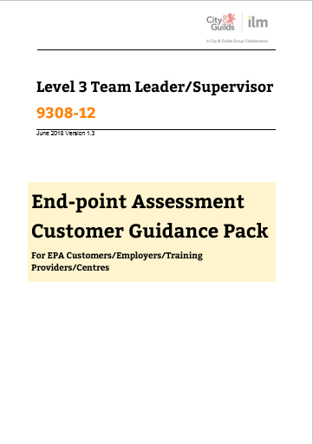
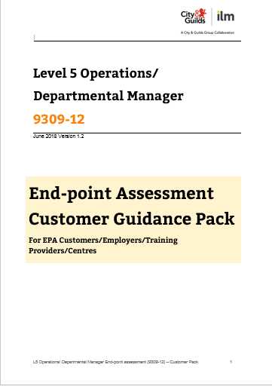
Links to Key Documents
ILM Customer Guidance packs, recording forms and sample tests linked on the left.
Lv3 Team Leader/Supervisor Apprenticeship Standard
Lv3 Apprenticeship Assessment Plan
Lv5 Operations/Departmental Manager Apprenticeship Standard
Lv5 Apprenticeship Assessment Plan
29

Slide 30
EPA resit fees
Knowledge test
Portfolio of evidence
Professional discussion
Competency-based interview
Presentation/Q&A based on project
Resit Fee
Level 3 | Level 5
£15 | £40
£235 | £255
£155 | £170
£220 | £255
 | £230
£625 | £950
Resit fees available on this page of our website.
Notes:
The structure of the fees is based upon the effort required to redeliver each component part.
The total amount charged is based upon the full EPA price minus the initial registration fee (£25)
NOTE – EPA £25 registration fee is only payable once. Not included in resit fees.
L6 and L7 resit fees, TBC.

Slide 31
EPA preparation tool
Quality assured generic content, aligned to occupations and EPA components
Tested by own in-house apprentices
Built following customer feedback – interviews, survey
Supports learner preparation for the EPA event
Presents unique and personalised experience for each learner
Availability
Accessed via SmartScreen, only to those centres making EPA registrations
Available for all occupations that have a City & Guilds or ILM EPA
Personalised to each apprentice with up to 6 hours of generic content per standard
Organised by assessment skills most relevant to the apprentice and the standard
Useful and relevant learning resources relevant to the standard and assessment method
Apprenitces can gain confidence in areas like interviews, presentation skills, writing and exam prep

Slide 32
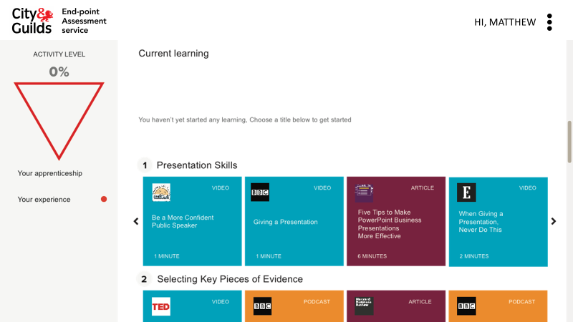
EPA Prep Tool
Useful learning resources relevant to the standard
HI, BENJAMIN
Relevant to assessment method
Organised by assessment skills most relevant to that individual and standard

Slide 33
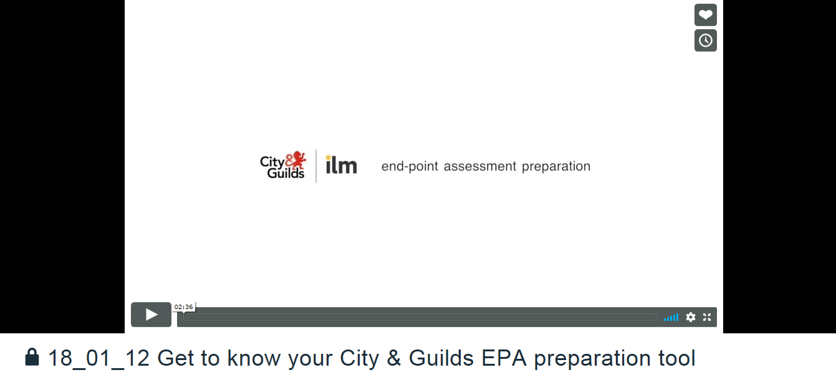
Demo video
URL: https://vimeo.com/250767683/af446c3150

Slide 34
Learning Resources

Slide 35
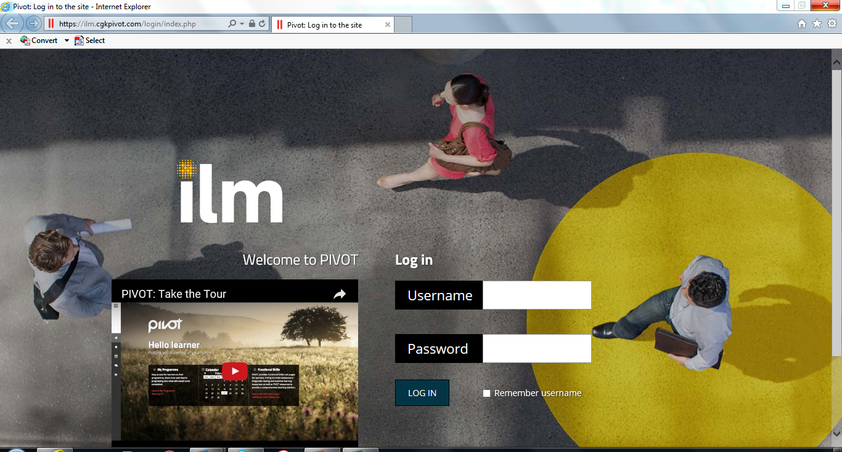
ILM Get To Gateway (formerly SOLAR)
The ILM Get To Gateway platform fuses award winning LMS and e-portfolio to manage qualifications, learners and assessors, all in one place.
Pricing is available on our website here: https://www.i-l-m.com/assessment-and-resources/ilm-learning-resources/apprenticeship-resources
Or discuss with your account manager if more information is needed.

Slide 36
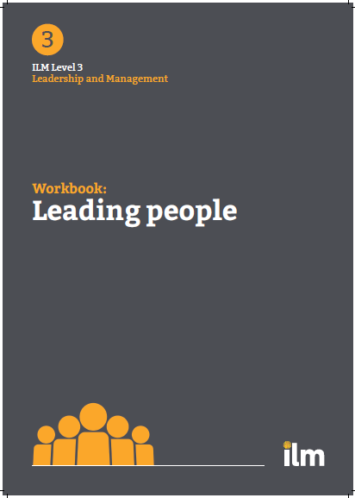
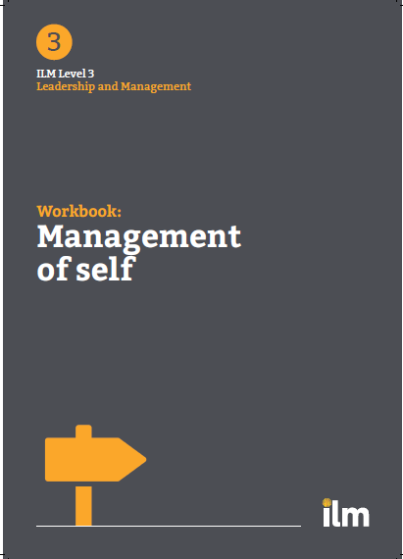
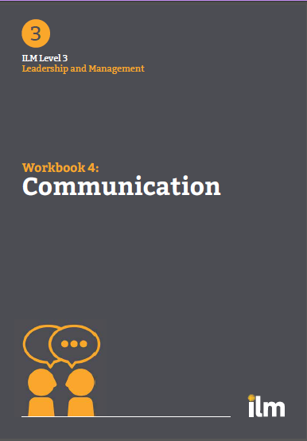
On Programme Resources – Illuminate e-Workbooks
Pricing
Level 3
Per user - £125 (Product code: WB3/DIG/PL1)
Unlimited users, Annual Licence fee - £12,250 (Product code: WB3/DIG/AL1
Level 5
Per user - £155 (Product code: WB5/DIG/PL1)
Unlimited users, Annual Licence fee - £15,500 (Product code: WB5/DIG/AL1)
One workbook per knowledge/skills unit (combined) covering each of the themes/topics within the qualification/apprenticeship standard. 10 workbooks for each qualification/level.
Aid to qualification delivery rather than a resource that generates assessment evidence
Primarily knowledge based with a ‘putting knowledge into action’ section. Provides opportunity for skills learned to be transferred to the workplace.
Writeable PDFs – can be saved and uploaded to LMS or ePortfolio
Mapped
Aid to delivery
Writeable PDFs
Notes:
One workbook per knowledge/skills unit (combined) covering each of the themes/topics within the qualification/apprenticeship standard. 10 workbooks for each qualification/level.
Primarily knowledge based with a ‘putting knowledge into action’ section. Provides opportunity for skills learned to be transferred to the workplace.
Aid to qualification delivery rather than a resource that generated assessment evidence (in the first instance).
At L3 ILM’s digital content library videos embedded within Workbooks.
Writeable PDFs – can be saved and uploaded to LMS or ePortfolio.
Separate mapping document linking workbooks to qualifications.

Slide 37
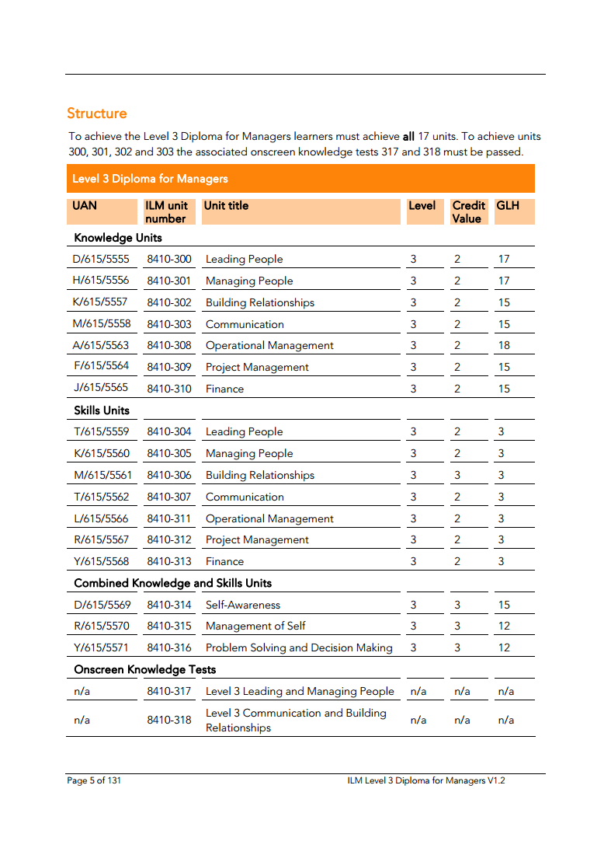
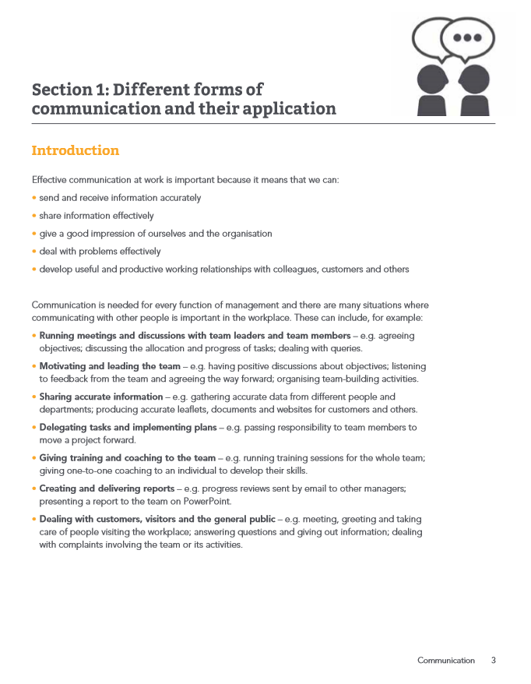
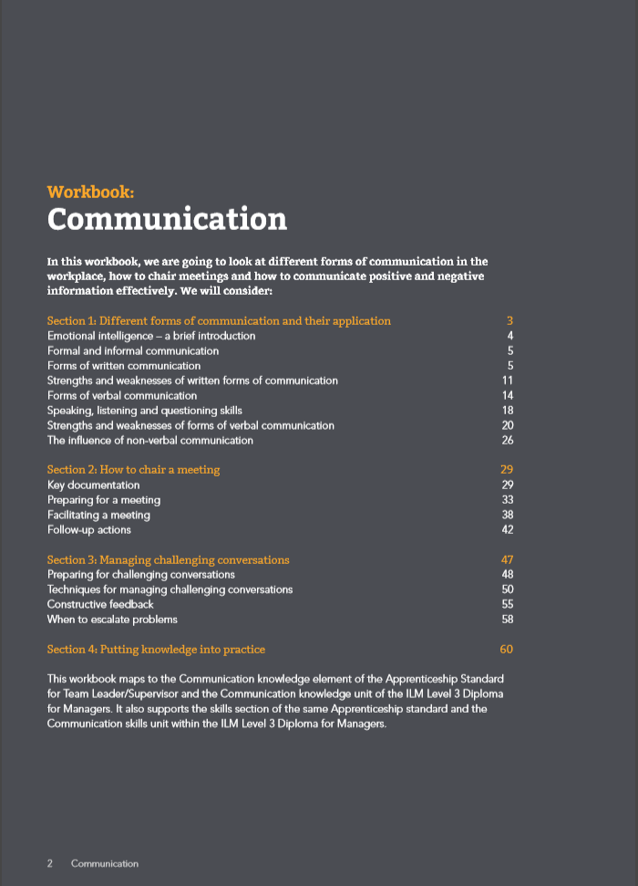
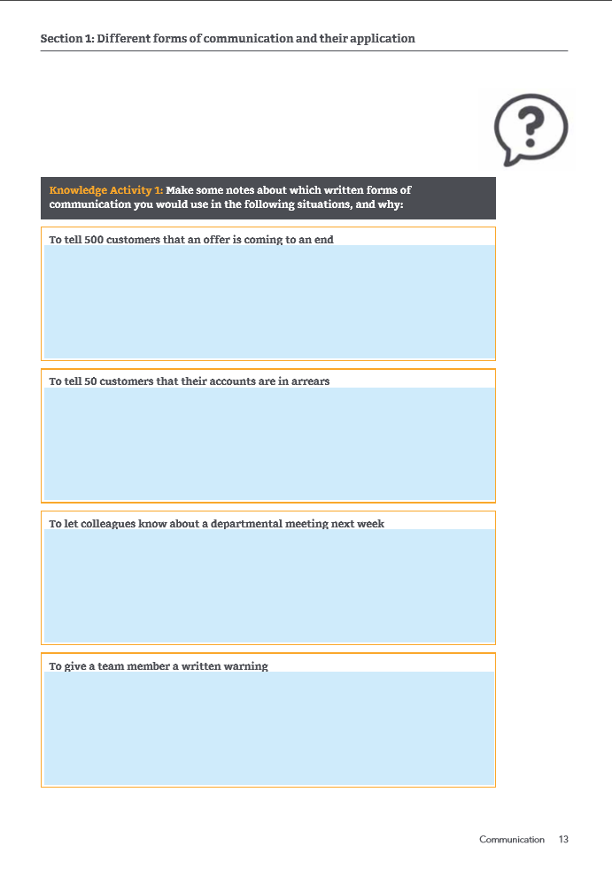
On Programme Resources – linking to the qualification handbook

Slide 38
Upcoming ILM webinars
Latest policy and funding news | Leadership and management qualifications | Coaching and mentoring qualifications | Digital products and services | Q and A
12/05
Best Practice professional Discussion and Interview | ILM EPA Requirements | ILM Management Standards – our End to End offer | Coaching & Mentoring Network | ILM Customer Update
Latest policy and funding news | Leadership and management qualifications | Coaching and mentoring qualifications | Digital products and services | Q and A
19/05
20/05
25/06

Slide 39
Thank you

