Slide 1
ILM EPA Pack
Level 3 Team Leader/ Supervisor
Brett Keegan – ILM Technical Advisor
Joe Ballantine – ILM Industry Manager

Slide 2
What we’ll cover
Level 3 Team Leader/Supervisor EPA Pack
  What’s in the pack and where’s the key info:
    Overview
    Explanation of key sections and what you’ll find in them
  Focus on assessment methods
    Key info on each method, what additional guidance we provide and where to find it.
    Portfolio focus:
      Evidence types
      Portfolio checklist to support evidence selection and preparation
  Additional documents available (Exemplar materials and mapping documents)

Slide 3
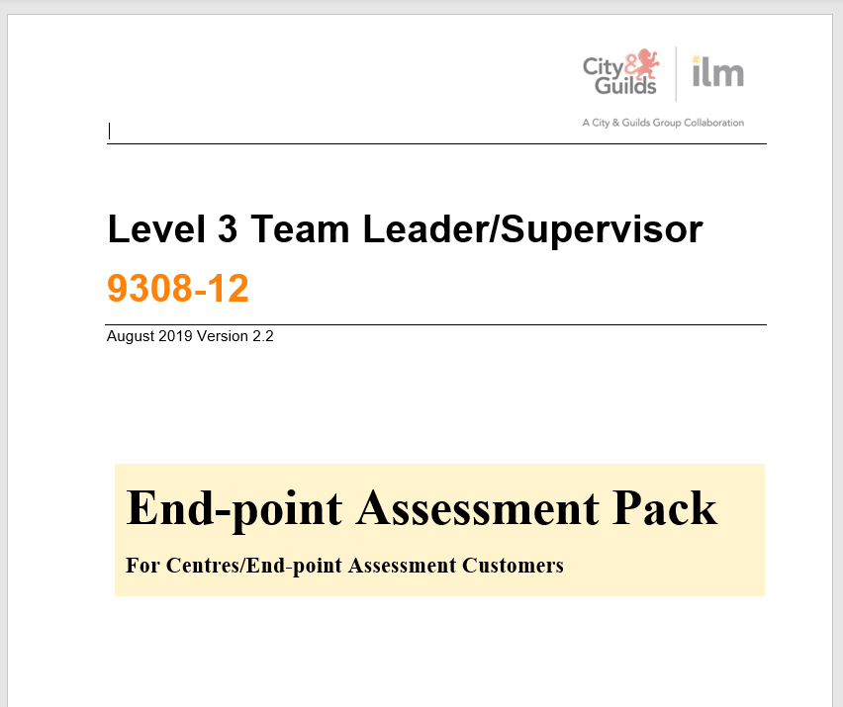
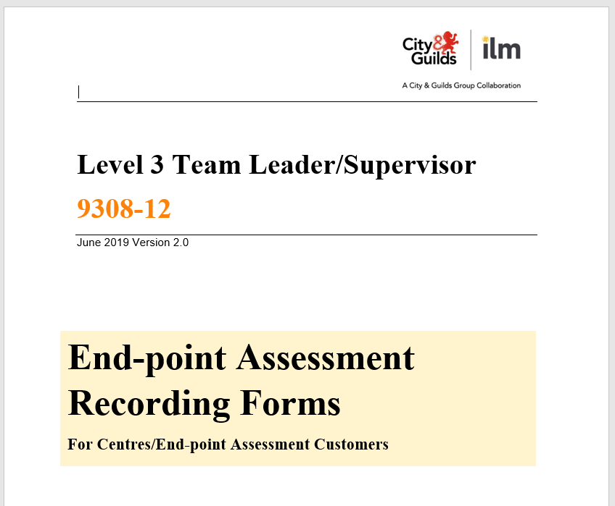
The Documents

Slide 4
End-point assessment pack – Key Sections
Section 1 Introduction – Who is the document for, using and storing the ILM EPA pack.
Section 2 The Standard and The Role – knowledge, skills and behaviours (KSBs) of the apprenticeship standard, and an overview of the key responsibilities an apprentice should have and examples of the types of job role they should be in whilst undertaking the apprenticeship.
Section 3 End-point Assessment Guidance – Guidance on the EPA process, looking at each stage apprentices, providers and employers will pass through, including requirements for gateway, recognition of prior learning (RPL) and authentication of work.
Section 4 Guidance for each assessment method – these include assessment specifications for each method, as well as instructions for both providers and apprentices on what will be assessed, how long assessments will last and what is required to allow each assessment to take place.

Slide 5
Knowledge Test (pages 19-21)
Assessment Specification
  Details of which areas of the apprenticeship standard are tested
  Details of the duration of the test, questions format, how many questions and marks there are and the pass mark for this assessment component.
  A breakdown of how the assessment is structured:
    How many AC are covered per section
    How many questions there are per section
    How many marks are available per section
Instructions for centres
  How to book the assessment, assessment conditions and a link to our Instructions for Conducting Examinations.
  Sample test provided in Appendix 1 starting on page 44.
At a glance:
Weighting = 30%
Total marks available = 30
Duration = maximum of 60 mins
Structured questions linked to a series of scenarios.
Online test using our E-volve platform
Notes:
Key section to support delivery and prep for EPA is the detail of the breakdown of the number of AC, questions and marks available. In support of this we have now also included the sample knowledge test in this document (pg 44) so info for the knowledge test is now in 1 document.

Slide 6
Professional Discussion (PD) relating to CPD Activity (pages 22-24)
At a glance:
Weighting = 20%
Based on any formal or informal learning undertaken during the apprenticeship, the knowledge gained and how it was applied.
Key to remember that this is a Professional Discussion, not a Q&A, so learners should be prepared to lead the conversation.
Carried out remotely using an online virtual meeting platform
Assessment Specification
  Details of what areas of the apprenticeship standard are assessed using this method.
  Details of what can be included as evidence of CPD/additional learning, which is what the Professional Discussion will be based upon.
  The duration of the professional discussion and what will occur during this time.
Instructions for centres
  Steps the provider and/or employer must take to ensure the apprentice is prepared and can undertake the assessment.
  Details of the Assessment Criteria (AC) that will be covered by this assessment method.
  Appendix 4 starting on page 85 provides guidance on areas of discussion for the PD and is a valuable tool in supporting apprentices to structure their PD to cover all of the AC required.
Notes:
As with other assessment methods it’s crucial for centres to have a full understanding of what is required to set up for and facilitate this assessment.
This section also then provides specific information on what AC will be covered – this will allow providers to focus there preparation activities and ensure the apprentice’s have the correct evidence and are able to confidently discuss the criteria identified to demonstrate their competency.

Slide 7
Structured Competency-based Interview (CBI)
(pages 25-27)
Assessment Specification
  Details of which areas of the apprenticeship standard are tested
  The purpose and duration of the CBI, and what will occur during this.
  Appendix 3 starting on page 83 provides examples of the types of question that could be asked for each section of the standard covered by this method.
  Appendix 3 also provides an overview of the approach the Independent End-point Assessor (IEPA) will take, and provides guidance including the importance of recognising and responding to the verbs used by the IEPA in their questions.
At a glance:
Weighting = 30%
Apprentices can have their portfolio with them to support answering questions
Example questions provided to allow for practice interviews to be carried out in preparation.
Carried out remotely using an online virtual meeting platform

Slide 8
Professional Discussion and Competency Based Interview
  Guidance
  Make Sure candidates are familiar with remote meetings/interviews
  Ensure the candidate is clear about the purpose of these activities
  For the Professional Discussion the learner should be clear on the purpose of CPD activity.
8
Notes:
Make Sure candidates are familiar with remote meetings/interviews– this just removes a barrier to performance and allows the candidate to focus on the actual assessment activity.
Ensure the candidate is clear about the purpose of these assessments – for example, the Professional Discussion will be a discussion, not a Q&A, and will be focussed on their development, not a team’s development.
For the Professional Discussion the learner should be clear on the purpose of their CPD activity. They should be able to provide a clear explanation of, and reflection on, the journey they’ve been on as an apprentice – rather than simply listing the activities they’ve undertaken with no additional explanation of the context.

Slide 9
Portfolio of Evidence (pages 28-34)
Assessment Specification
  Details of which areas of the apprenticeship standard are tested
  A list of evidence types that can form part of the portfolio
  Key requirements when submitting the portfolio, including:
    A Declaration of Authenticity
    An Evidence Matrix must be included
At a glance:
Weighting = 20%
Submitted via our online EPA Portal
Notes:
A Declaration of Authenticity, which must be included and can be found in the Recording Forms pack.
An Evidence Matrix must be included, demonstrating how the evidence presented maps to the required Assessment Criteria and can be found in the Recording Forms pack.
The portfolio should cover the totality of the standard and showcase the apprentice’s best work.

Slide 10
Portfolio of Evidence (pages 28-34)
Guidance for providers including:
  Evidence presented must have been generated over the period of the apprenticeship only
  Additional detail on evidence types and clarification on the level of detail that should be included in evidence
  Key questions/criteria to support the selection of evidence, and key steps in confirming and preparing evidence for submission
Notes:
Evidence presented must have been generated over the period of the apprenticeship only (work produced prior to being an apprentice can not be included, an initial assessment/skills scan should identify whether this represents prior learning or existing knowledge/skills).
Additional detail on evidence types and clarification on the level of detail that should be included in evidence, e.g. where group work is presented the role and contribution of the apprentice must be made clear.
Key questions/criteria to support the selection of evidence, and key steps in confirming and preparing evidence for submission, e.g. ensuring clarity of recordings and images, titling conventions.

Slide 11
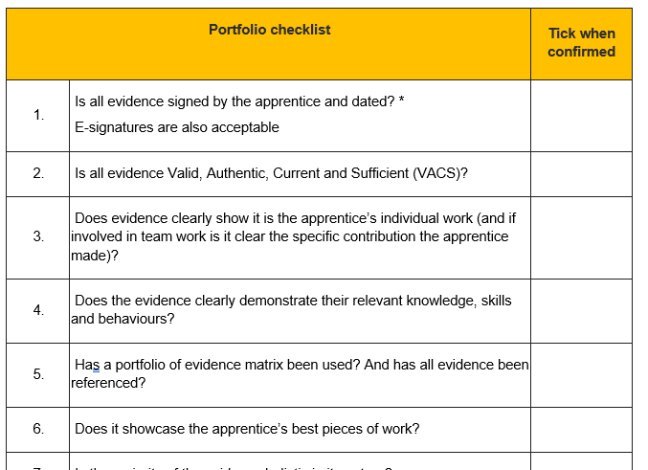
Portfolio Checklist (page 30)
Additional guidance for the portfolio of evidence:
  A Portfolio Checklist, which includes 13 questions to ensure all relevant information is included
Notes:
This is a key tool in supporting the creation of an EPA portfolio based on the apprentice’s on-programme portfolio – these are the key questions you should be asking in relation to the evidence being carried forward to EPA.

Slide 12



Portfolio of evidence – Evidence types
Work products
Reports
Presentations
Performance reviews between employer and apprentice
Observations (recorded by the training provider)
Ongoing professional discussions between apprentice and training provider relating to projects and assignments (recorded by the training provider)
Feedback from line manager, direct reports and peers including 180/360 degree feedback approaches
Reports
Presentations
Work products
12
Notes:
Examples
Work products – This is evidence produced whilst the apprentice is doing their job, primary evidence to demonstrate that action has happened and that a level of competence has been displayed to produce an output. This must be contextualised by supporting evidence to show the candidates contribution and role in producing it.
Reports – report for managers demonstrating product performance, market/customer intelligence, own product vs customers
Presentations - team meeting agenda and slides used to present the team strategy and purpose
Performance reviews between employer and apprentice – these can provide secondary evidence to support primary product evidence, this should be focussed on meeting/mapped to specific criteria and not just a broad, general open discussion.
Observations (recorded by the training provider) - Observation records of them communicating to the audience in different ways, e.g. formal presentation to other Team Leaders/Manager and an informal communication style used in a team huddle.
Ongoing professional discussions between apprentice and training provider relating to projects and assignments (recorded by the training provider) -
Feedback from line manager, direct reports and peers including 180/360 degree feedback approaches -

Slide 13
Appendix 2 Portfolio Assessment Guidance
(pages 59-81)
This section is focussed on providing additional detail around the evidence expectations for the Portfolio.
This section contains a new table with the following columns:
  Within this table the “Skills” column identifies a specific area of the standard, e.g. Leading People.
  The “What is required” section identifies specific Assessment Criteria
  Then the “Guidance on evidence types and the quality of evidence” section identifies how the AC identified are measured and examples of what evidence could be for each of these AC.

Slide 14
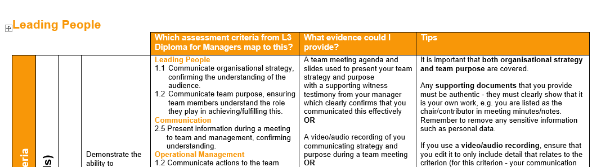
Portfolio of Evidence
  Mapping portfolio from 8410 to EPA
  This includes:
    how criteria from 8410 map to EPA criteria.
    examples of what this evidence could be and how it should be checked and prepared for submission.
Notes:
In addition to this checklist we have also provided a mapping document for customers using the Level 3 Diploma for Managers (8410), this illustrates how evidence created and used within 8410 should be selected to form part of the EPA showcase portfolio.

Slide 15
General guidance for the portfolio
  The Portfolio needs to holistically show:
  Acquisition and demonstration of skills
  Demonstration of behaviours
  Evidence collected towards the end of their apprenticeship program, as candidates become independent in their work and complete larger activities, is likely to provide the most holistic evidence
  Contextualisation by learners is key
  Apprentice’s role in producing the work must be clear
15
Notes:
Acquisition and demonstration of skills
Demonstration of behaviours
Evidence collected towards the end of their apprenticeship program, as candidates become independent in their work and complete larger activities, is likely to provide the most holistic evidence - i.e. covering a number of criteria at once. From this, they should select evidence that most efficiently meets all the relevant criteria and which demonstrates their best performance.
Contextualised – Contextualisation by learners is key, it allows them to demonstrate the role they played in creating the evidence presented, and provides a platform for the learner to demonstrate why they made decisions, why they chose to implement a certain model, etc.
Apprentice’s role in producing the work must be clear – especially where work produced by a team is presented, it must be clear what role the candidate played in producing work presented.

Slide 16
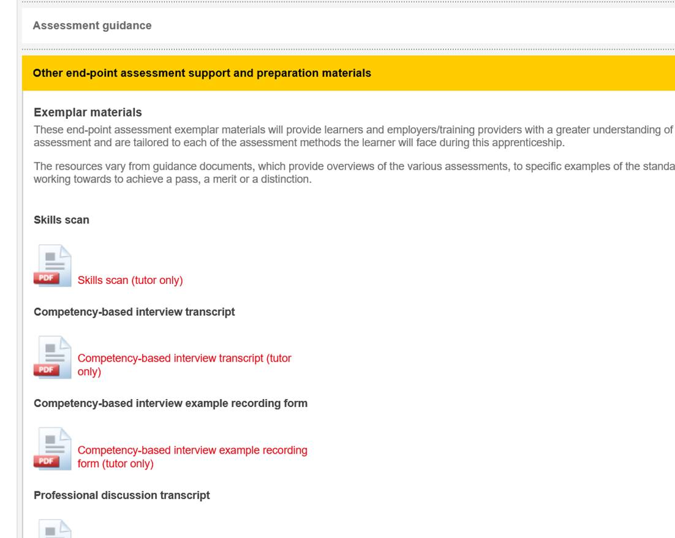
Exemplar Materials
New exemplar materials for Level 3 Team Leader/
Supervisor End-point assessment
Exemplar materials include:
  Skills scan
  Professional discussion transcript
  Professional discussion example recording form
  Competency-based interview transcript
  Competency-based example recording form

Slide 17
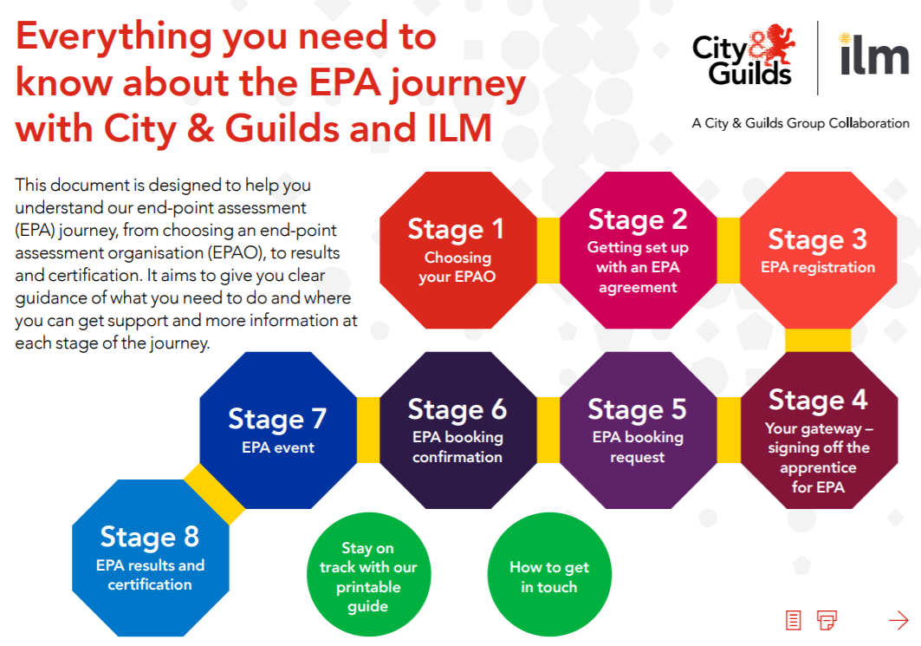

Slide 18
Questions
answers

Slide 19
Key documents and contacts
Key Documents
EPA Pack, Recording Forms and Mapping document
Walled Garden Booking Guide
EPA Portal Guide
8 Steps – EPA Journey
Key Contacts
EPA Support Team - epasupport@cityandguilds.com
Brett Keegan, Technical Advisor for Leadership & Management – brett.keegan@cityandguilds.com
Rebecca Hollamby, EPA Partnership Manager - rebecca.hollamby@cityandguilds.com
Joseph Ballantine, Industry Manager Leadership and Management - Joseph.Ballantine@i-l-m.com

Slide 20
Thank you

